Slide 1
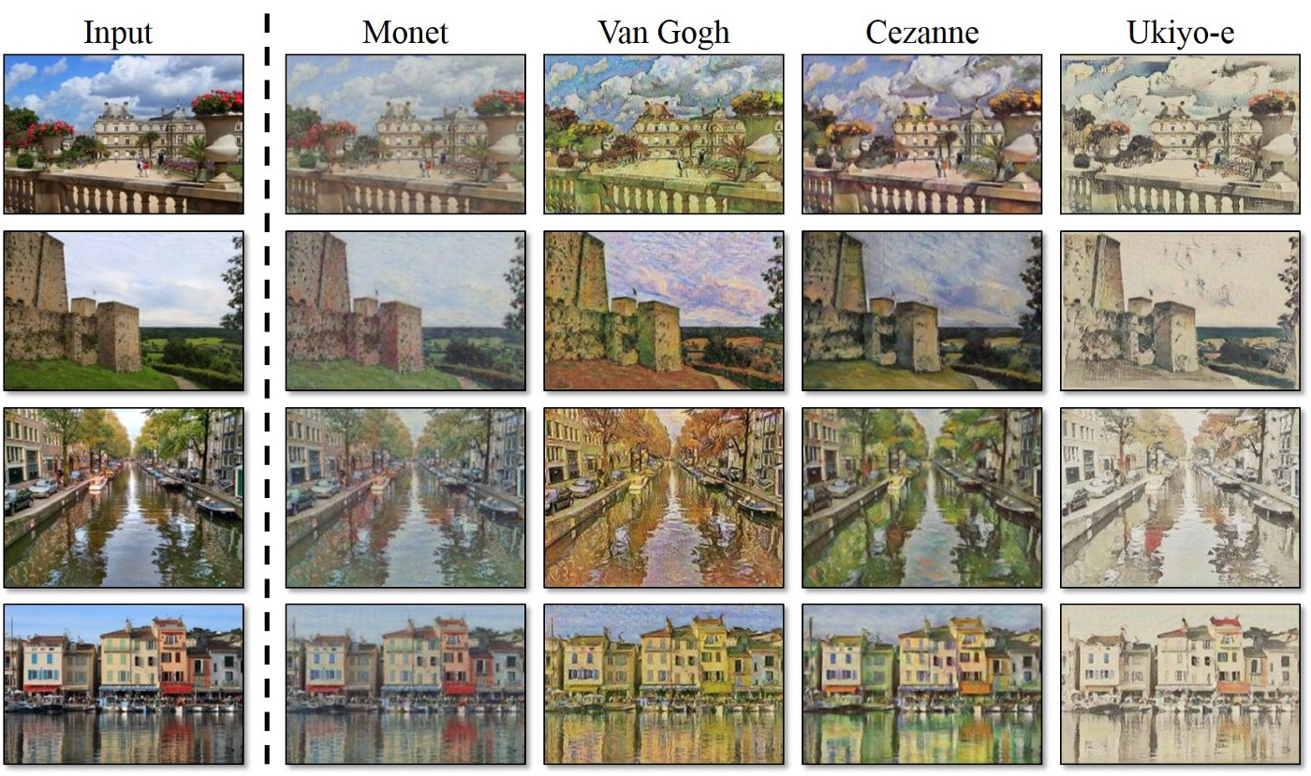
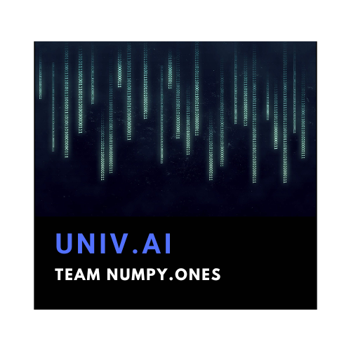
Cycle GANs To Generate Ukiyo-E Art
Image-to-image translation involves generating a new synthetic version of a given image with a specific modification. The CycleGAN is a technique that involves the automatic training of image-to-image translation models. The models are trained in an unsupervised manner using a collection of images from the source and target domain that do not need to be related in any way.
AI – 4 Project | Team Numpy. Ones | Abhineet Sharma

Slide 2
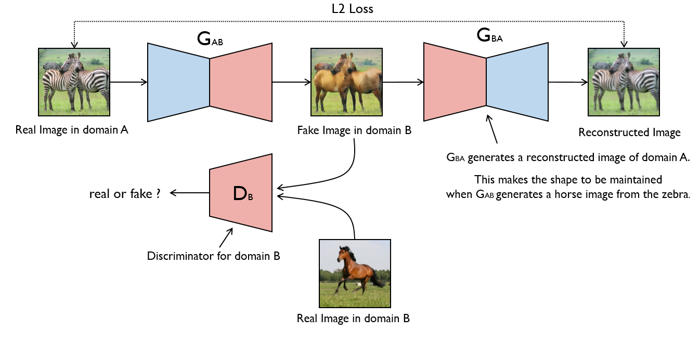
What are CYCLE GANs ?
The CycleGAN is a technique that involves the automatic training of image-to-image translation models without paired examples. The models are trained in an unsupervised manner using a collection of images from the source and target domain that do not need to be related in any way.

Slide 3
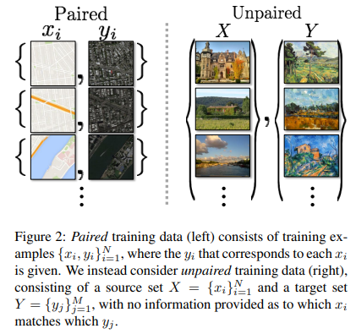
Unpaired Vs Paired Samples
Traditionally, a dataset made up of paired samples is needed to train an image-to-image translation model.
That is, a sizable collection of numerous instances of input photos X (for instance, summer landscapes) and the same image modified in the desired way that can be used as an anticipated output image Y (e.g. winter landscapes).
A drawback is a demand for paired training datasets. The preparation of these datasets, which include images of various settings taken under various lighting conditions, is difficult and expensive.

Slide 4
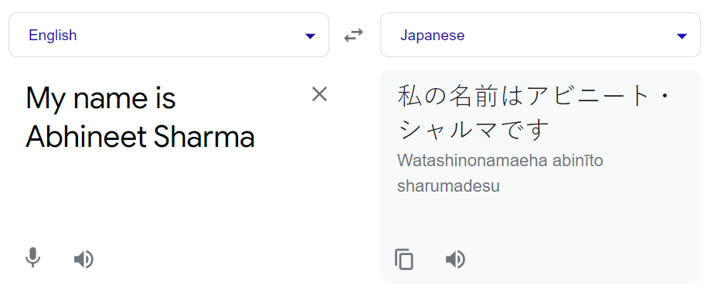
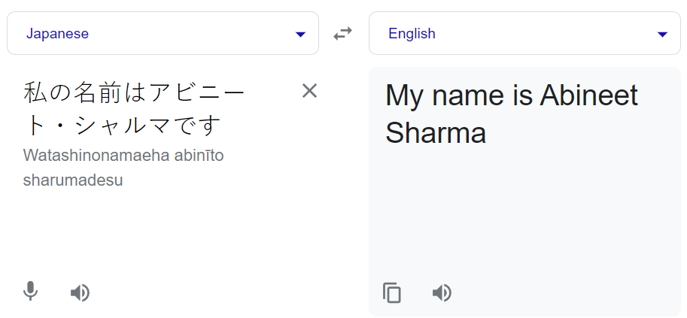
What is Cycle Consistency ?
A phrase that is translated from English to French should be translated from French back to English and be exactly the same according to the machine translation principle known as cycle consistency.
The opposite should likewise be true of the process.
By including an additional loss to calculate the difference between the output of the second generator and the original picture, and vice versa, the CycleGAN promotes cycle consistency. As a result, the generator models are regularised, directing image generation in the new domain in the direction of image translation.

Slide 5
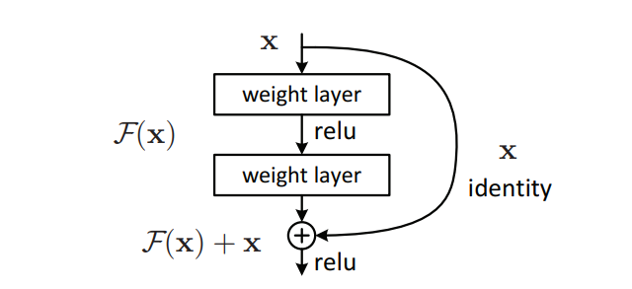
Residual Blocks?
By placing numerous residual blocks on top of one another, a residual network is created.
To avoid the performance deterioration issue with deep neural networks, the residual blocks provide an identity mapping to activations earlier in the network.
The issue of vanishing gradients and expanding gradients is helped by the skip connections.
The paper uses ResNet-9 i.e. 9 residual blocks are used in the generator network.

Slide 6
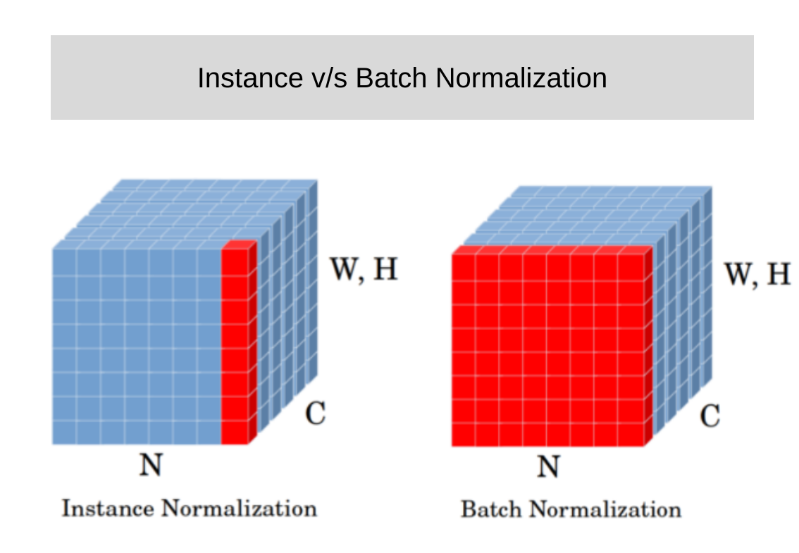
Instance Normalization
Contrast normalization is referred to by another name; it was initially used in the StyleNet publication. Both names give away some details about this method. It operates on a single sample, as shown by instance normalization.
Contrast normalization, on the other hand, claims to normalize the contrast within the sample's spatial components.
We may also state that IN, given a Convolution Neural Network (CNN), accomplishes intensity normalization over the width and height of a single feature map of a single example.

Slide 7
Cycle GANs Architecture
The Entire architecture comprises four models, two generators, and two discriminators for the 2 collections of images viz Ukiyo-E-Art and the Scenery.
Functional API is used for building the Generators and the Discriminators.
The Generator implements the Instance Normalization Layer
As mentioned in the paper, 9 Res-Net blocks are used to improve the model’s performance.
The Discriminator uses the Instance Normalization Layer and LeakyReLU as the activation function
Finally, the composite model is defined with trainable parameters set to True/False based on the training, and the identity element is preserved.
The losses are given precedence based on the loss weights list passed in the .compile function.
The Cycle loss has the most weight loss_weights = [1,5,10,10].

Slide 8
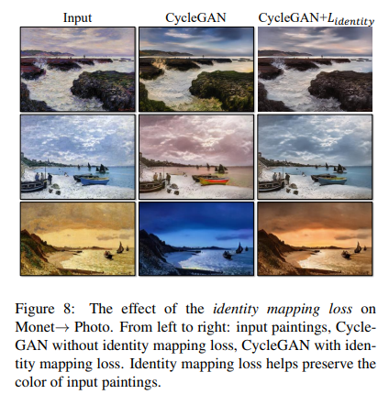
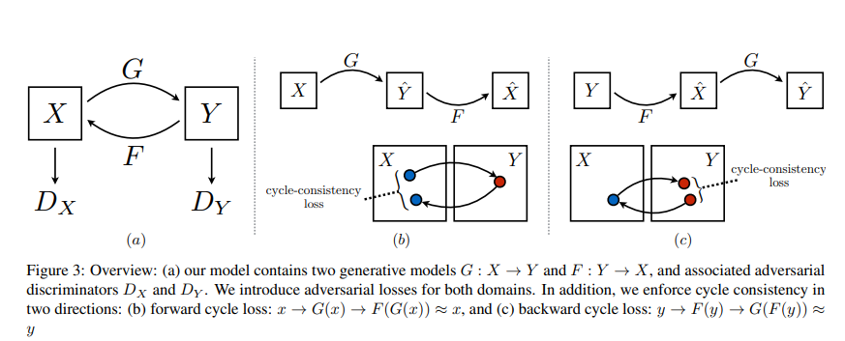
Losses in CycleGANs
Adversarial Loss: Domain-B -> Generator-A -> Domain-A -> Discriminator-A -> [real/fake]
Identity Loss: Domain-A -> Generator-A -> Domain-A
Forward Cycle Loss: Domain-B -> Generator-A -> Domain-A -> Generator-B -> Domain-B
Backward Cycle Loss: Domain-A -> Generator-B -> Domain-B -> Generator-A -> Domain-A

Slide 9
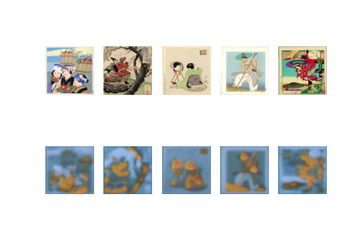
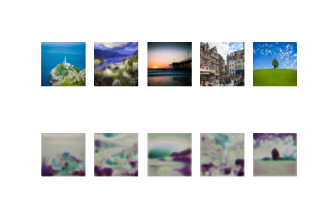
Results
The model ran for one Epoch and the sampled images were just 20 for each collection taken from both train and test sets combined
Generated from A to B
Generated from B to A

Slide 10


